Slide 1
Data Quality
A Great CRM Starts with Great Data
Sugar Professional Services
Michael Baecker
mbaecker@sugarcrm.com

Slide 2
Six Ways to Improve Data Quality
To avoid the worst-case, “garbage in, garbage out” scenario with your CRM data, you need to focus on streamlining the process for your end-users
If you follow the following 6 CRM data management best practices listed here, you will see more people using your CRM, and using it well
AUTOMATED DATA AUGMENTATION
DATA RESPONSIBILITY
REQUIRED FIELDS
CLEANUP INITIATIVES
STANDARDIZATION
INTEGRATING DATA FROM OTHER SYSTEMS

Slide 3
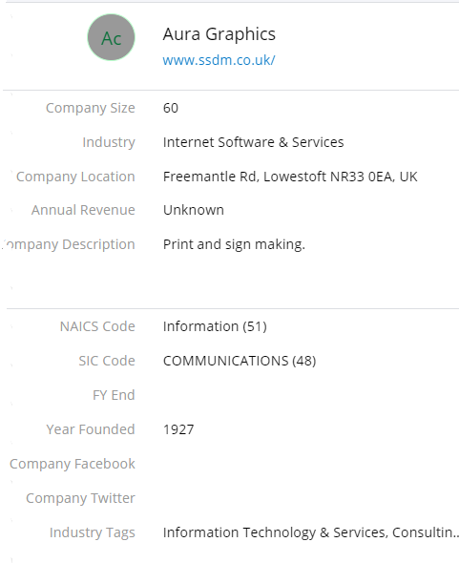
Automated Data Augmentation
Using Sugar Hint
Hint is a data enrichment service that automatically gathers and analyzes actionable insight from a broad range of social and business data sources by leveraging names and email addresses already stored in Sugar
Users can quickly import the enriched data into Sugar with a single click, saving time and eliminating human error

Slide 4
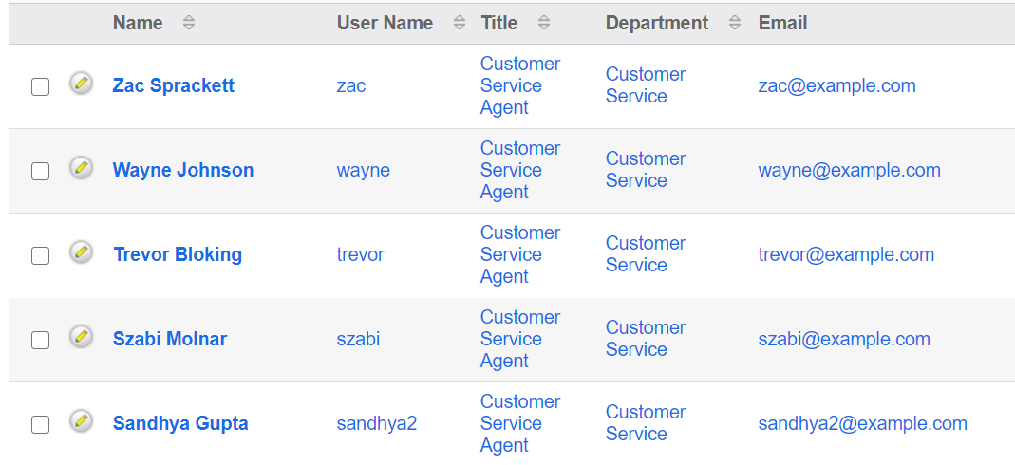
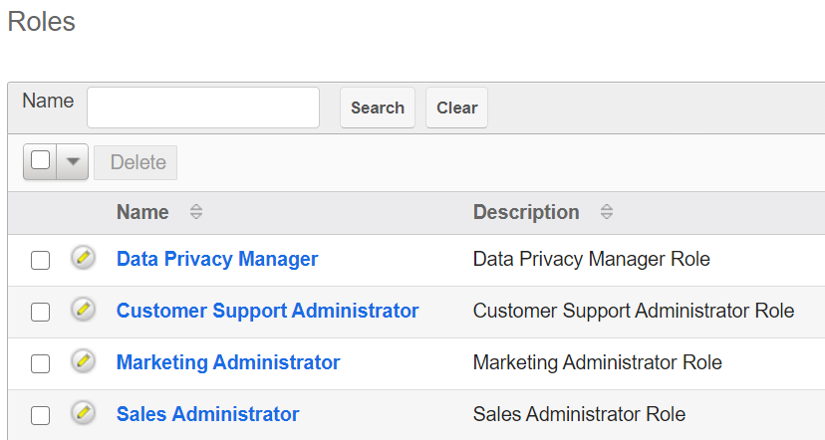
Data Responsibility
Make sure the data is assigned to real people who take responsibility!
Avoid shared logins: when users share credentials, no one feels responsible for the data quality
Use Sugar’s AUDIT TRAIL function: when users access SugarCRM through shared credentials you are unable to determine who did what and no responsibility for the quality is guaranteed. By using individual credentials, you can take advantage of the Audit Trail
Use the “Assigned User” field: when records are assigned to a single owner in SugarCRM, then one person is responsible for the quality and completeness of that record

Slide 5
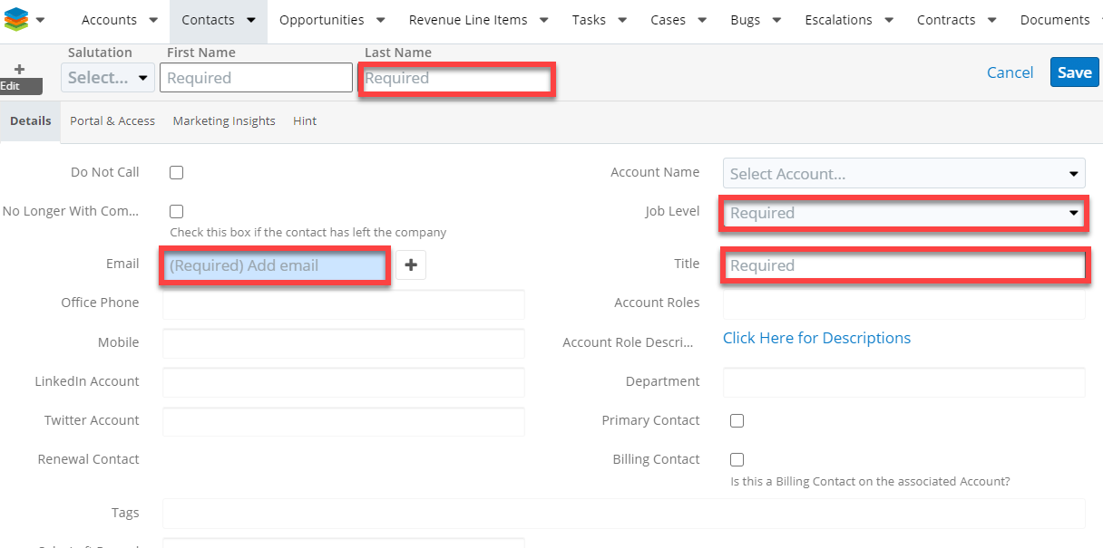
Required Fields
In an ideal world, we would not need required fields… BUT often certain fields
Drive processes for automation
Enable the segmentation for marketing to create target lists
Provide input for reports or dashboards.
When data is NULL in these fields, the effectiveness is reduced dramatically, or even worse, the reporting cannot be trusted.

Slide 6
Clean-up Initiatives
Merge Data Sets
Rebuild Missing Data
Standardize Data
De-Duplicate
Verify and Enrich
Undertake an active initiative to complete records with missing data, look for duplicates, and update incorrect information
Distribute responsibilities for updating the data internally through:
Running a report of desired data for clean-up
Using Sugar Tags to assign records that need correction to specific users
Utilize third-party vendors who provide data cleansing services

Slide 7
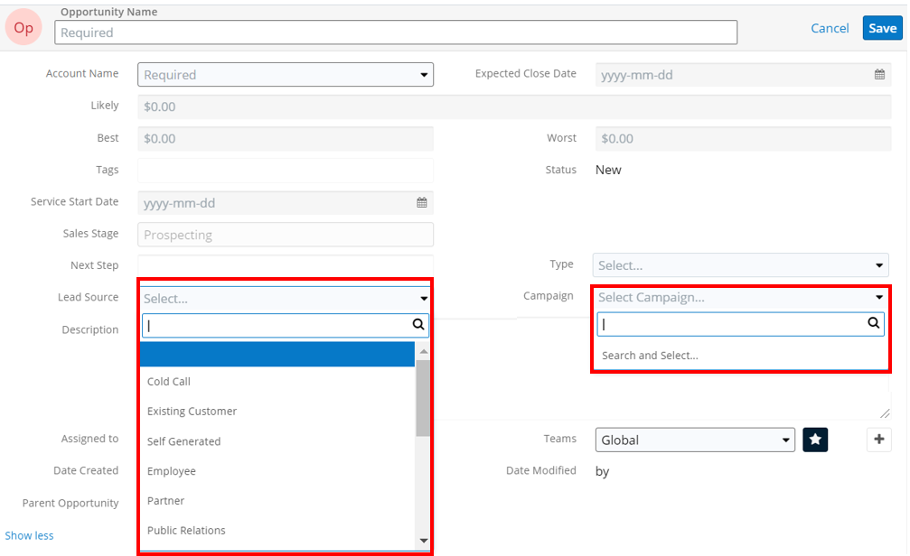
Standardization
Standardize common fields by utilizing drop-downs or multi-select fields in lieu of free text
Lead Source, Industry, Country, Status, etc.
Creating standard options will:
Improve data quality
Allow for better reporting
Allow for segmentation for marketing automation, such as in Sugar Market

Slide 8
Integrating Data from Other Systems
Data consolidation aims at capturing the data from multiple, heterogeneous source systems and integrating it into SugarCRM
The extent of data integration will depend on the required quality of service characteristics.
Data quality depends on the data quality of the source system and a clean up routing is recommended prior to integration and migration efforts

Slide 9
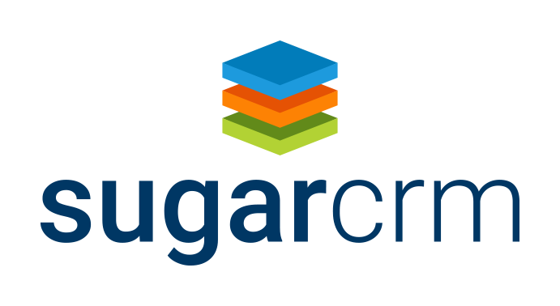
How we can help
Get technical and strategic advice from our experts with deep knowledge across disciplines
Our business analysts, solution architects, and engineers will work with you to:
Review your solution
Oversee complex data quality and integration issues
Improve end-user adoption
Notes:
A Mission Statement defines the company’s business, its objectives and its approach to reach those objectives.
The Mission Statement focuses on today and what the organization does.
Answers 3 questions:
What do we do?
Whom do we serve?
How do we serve them?
“We do good work with good people. Through trusting partnerships, we build and distribute powerful visual content that educates, engages, and inspires.”

